Slide 1
Connecting Microservices Through Messaging

Slide 2

The role of messaging in microservices
Problems with the status quo Describing Spring Cloud Stream Explaining the programming model Building processors
Overview
Advanced binder properties
Using consumer groups to scale Stateful processing with partitions Working with content types Monitoring stream health Summary

Slide 3
Capabilities That We Will Add in This Module
Toll Data Repository
Toll Station UI
Service Discovery
Load Balancer
Circuit Breaker
API Gateway
 | Messaging
Toll Intake Service
Fast Pass Service
Remote Toll Data Pipeline
Toll Rate Lookup Service

Slide 4

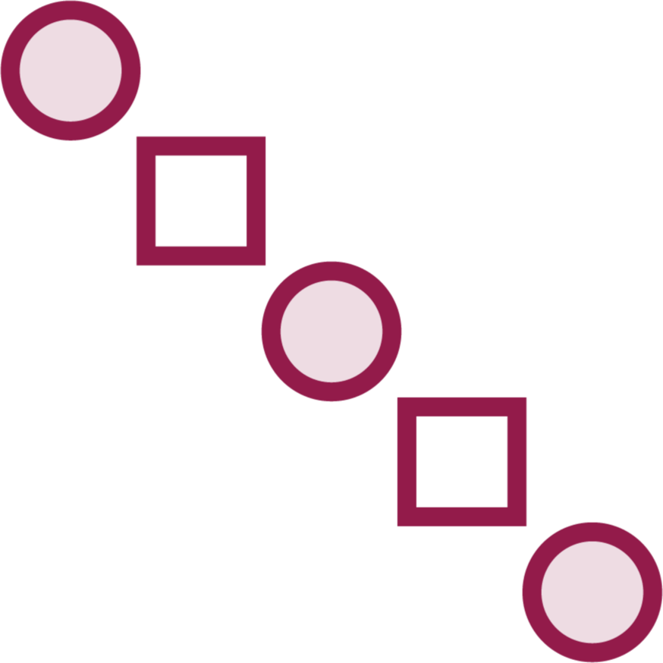
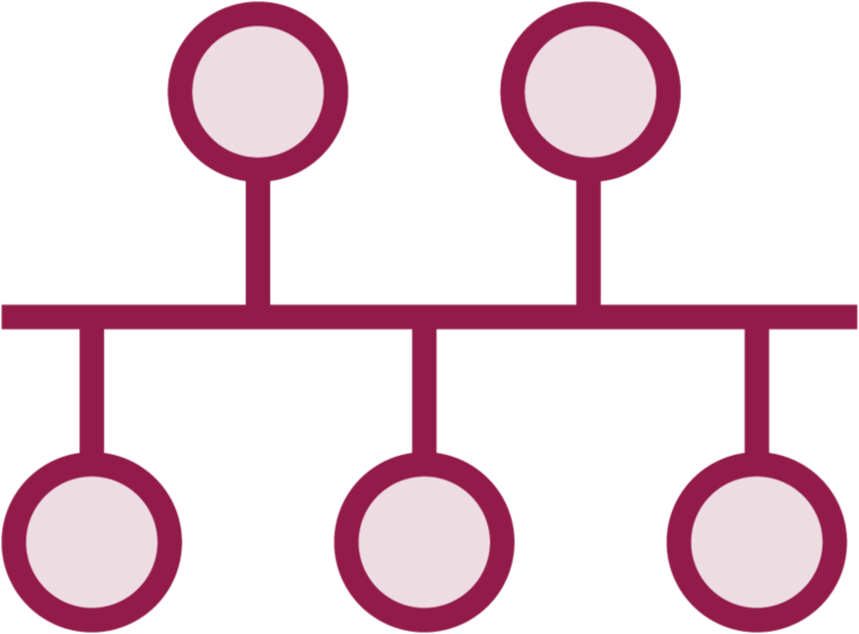

The Role of Messaging in Microservices
Embrace loose coupling
Improve scalability and reliability
Introduce new intake and processing patterns
Interact with legacy systems

Slide 5

Problems with the Status Quo
Messaging is often the realm of experts
Tight coupling creates fragility Fixed flows and rigid endpoints
Legacy tools don’t make event-driven architecture easy

Slide 6
Spring Cloud Stream
Framework for building message-driven microservices apps.

Slide 7
Relationship with Spring Integration
Spring Integration primitives assist in connecting to message brokers
Possible to use with Spring Integration annotations, but no longer recommended
Complex Spring Integration flows can be exposed as functions and used in Spring Cloud Stream

Slide 8




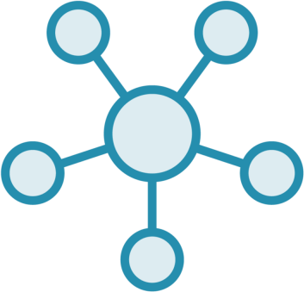

Spring Cloud Stream Core Concepts
Inputs/outputs in code talk to destinations through bindings
Bindings abstract middleware-specific binders
Publish/subscribe pattern at the core
Functional programming model now standard
Consumer groups support competing consumer pattern
Stateful processing possible with partitioning

Slide 9
Comparing the Annotation and Function Models
Classic annotation model
@EnableBinding activates for Source,
Sink, or Processor
Could use Spring Integration’s
@InboundChannelAdapter annotation
@StreamListener for receivers @SendTo annotation for output from a
processor
Functional model
Uses Java’s functional programming
model
Framework conventions bind function handlers to input/output bindings
Uses StreamBridge for dynamic destinations
Result of Function goes to output destination

Slide 10

Explaining Binders
Connects you to physical endpoints in the external middleware
Spring Cloud detects binders on classpath Can connect to multiple brokers of same type Can also use different binders with same code Possible to write your own binder

Slide 11

◀ Supplier bean maps to message publisher
@Bean
public Supplier<String> supplyStr(){ return () -> "example message";
}
...
@Bean
public Supplier<Flux<String>> supplyStrStream() {
ArrayList<String> names = new ArrayList<String>();
names.add(”Walt");
names.add(”Vic");
names.add(”Ferg");
//sends three messages to the queue return () -> Flux.fromIterable(names);
}
◀ By default, produces a message every second
◀ Supports reactive programming style
◀ Framework recognizes this style and only invokes once

Slide 12
◀ Functional binding name follows structure
<functionName> + -out- + <index>
spring.cloud.stream.bindings.supplyStr- out-0.destination=stringtopic
◀ “Destination” refers to messaging endpoint in
physical binder
spring.cloud.stream.bindings.supplyStr- out-0.content-type=text/plain
#spring.cloud.stream.poller.fixed-delay
= 5000
◀ For imperative-style beans, can control polling interval
spring.rabbitmq.host=127.0.0.1
spring.rabbitmq.port=5672 spring.rabbitmq.username=guest spring.rabbitmq.password=guest
◀ May also have connection details for specific binder

Slide 13
◀ Subscribers can be Consumer or Function
@Bean
public Consumer<String> getStr() { return value -> { System.out.println("received message -
" + value);
};
}
...
@Bean
public Consumer<Flux<String>> reactiveGetStr() {
return value -> value.subscribe(v -> {
System.out.println(v);});
}
◀ A Consumer can be reactive as well

Slide 14
◀ Functional binding name follows structure
<functionName> + -in- + <index>
spring.cloud.stream.bindings.getStr-in- 0.destination=stringtopic
spring.cloud.stream.bindings.getStr-in- 0.content-type=text/plain
◀ “Destination” refers to messaging endpoint in
physical binder
spring.rabbitmq.host=127.0.0.1
spring.rabbitmq.port=5672 spring.rabbitmq.username=guest spring.rabbitmq.password=guest
◀ May also have connection details for specific binder

Slide 15

Demo
Start up RabbitMQ Docker container
Create new project via Spring Initializr Add Stream dependencies
Create message sender in ”fast pass UI”
that publishes messages every second
Create message receiver in new project that processes streams of incoming messages

Slide 16
More Options for Producing Messages
Expose functions based on Enterprise Integration Patterns from Spring Integration
StreamBridge for direct send to an output
Send messages in batch to the output

Slide 17
More Options for Consuming Messages
Set conditions to dispatch to different functions
Compose functions using pipes
Receive data in batches
Receive data in Function and forward on to another destination

Slide 18
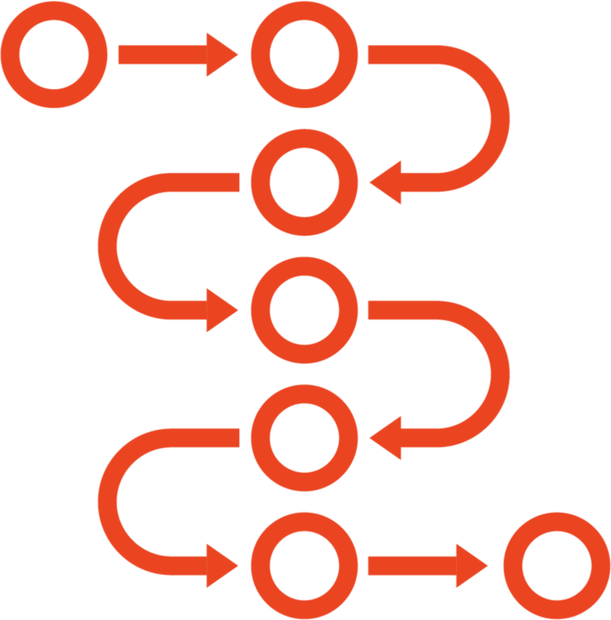
The Role of Processors in Spring Cloud Stream
Stream app that sends AND receives
Function response goes to output destination
Has inbound and outbound binding configurations
Possible to use different broker instances, or types for the inbound/outbound channel

Slide 19
Demo
Create processor and see toll payment message continue on to next queue
Dispatch a message to conditional subscriber

Slide 20
RabbitMQ Binding Properties
Set up connection using spring.rabbitmq.*
Maps destination to an Exchange Queue bound for each Consumer Group
Capable of handling retries (maxAttempts)
Can set routing key, point to existing queue, or change exchange type
Support for dead-letter queues
Control concurrency, header behavior, batching
RabbitMQ

Slide 21
Apache Kafka Binding Properties
Support for Kafka and Kafka Streams
Setup broker and Zookeeper references Map destination to Kafka topic Partitions, consumer groups map directly Create new topics, or use existing ones Define replication, rebalancing behavior Control over offset handling
Apache
Kafka

Slide 22



Using Consumer Groups to Scale
Use to scale out subscribers. Message goes to single instance in each group
Consumer group subscriptions are durable; when consumer group NOT specified, subscription is non-durable by default
Set spring.cloud.stream.bindings.<channelName>.group property

Slide 23
Demo
Add new REST endpoint to toll rate UI app that sends to queue upon request (not polled)
Add consumer group property to receiver, observe change in RabbitMQ
Start multiple instances of toll intake receiver application and observe behavior

Slide 24

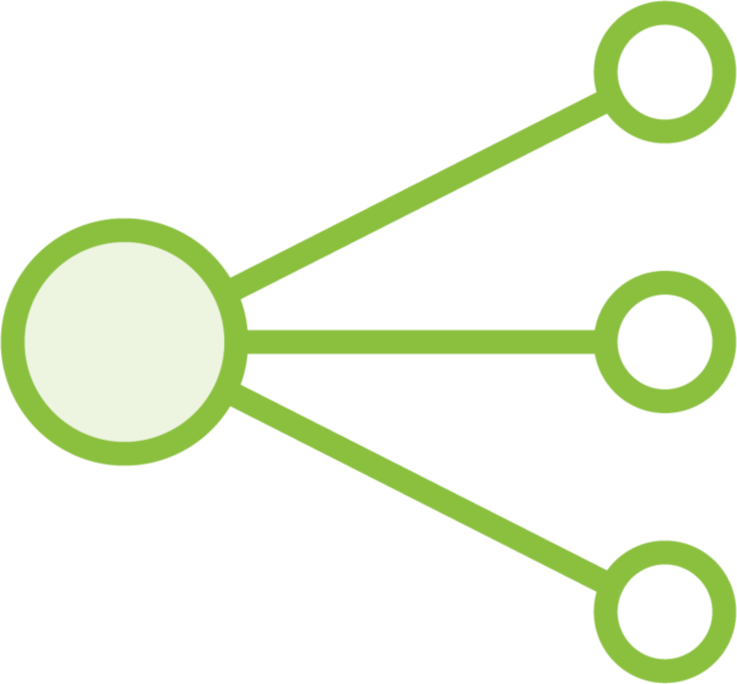

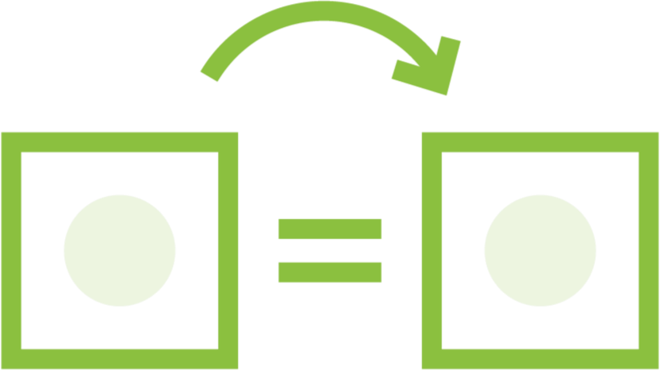
Stateful Processing with Partitions
Modeled after Apache Kafka behavior
Data split, processed by unique consumer instance
Useful for load balancing, stateful processing
Required properties for producer, consumer

Slide 25
Demo
Add partitioning based on customer
Update receiver to store data for each fast pass customer
Update sender to be aware of partition count
Start up receivers with arguments indicating the instance index
Submit messages and see which partition gets it

Slide 26
Working with Content Types
Applies MessageConverter based on content type set in header or binding
If no content-type is set, message assumed to be JSON
Four MessageConverters included by default
Can define and register your own MessageConverters

Slide 27

Spring Cloud Stream Health and Metrics
Monitor health of individual binders
Emit metrics to Spring Boot Actuator endpoint Process metrics in your monitoring system

Slide 28
Describing Spring Cloud Stream
Explaining the programming model Building processors
The role of messaging in microservices
Problems with the status quo
Summary
Advanced binder properties
Using consumer groups to scale Stateful processing with partitions Working with content types Monitoring stream health

